Slide 1


BAN 140 Project Milestone 3
Group 3
Chahat Kaur Chhabra
Kajal Rajan
Mahesh Kumar Amda
Amandeep Singh Saluja

Slide 2

Agenda
01
Target Audience
02
MCI’s
03
Key findings
04
Conclusion and recommendations
03
Notes:
Our agenda for today’s presentation is-
First- our target audience
Second – Introduction to our major crime indicators dataset
Third – our key findings
4. Conclusion and recommendation.
So lets begin-

Slide 3
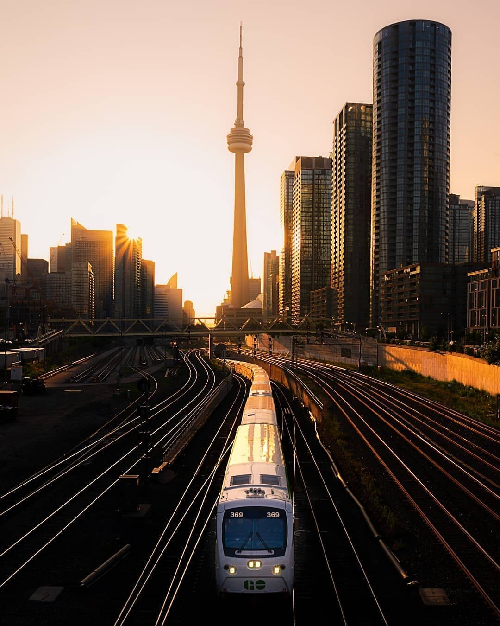

Toronto– 6th safest city in the world
So, while Toronto may be ranked as one of the safest cities globally, but fellow Canadians comment that when it comes to Canadian safety, Toronto doesn't quite reach our standards.
https://globalnews.ca/news/5829962/toronto-safest-cities-index-2019/
Notes:
According to the global news canada, Toronto is ranked as the 6th safest city in the world, while their are also people who comment about the safety with increasing crime rate in toronto when compared to the other canadian cities.

Slide 4

Target Audience
Senior leadership of The Toronto Police Department Service.
General public.
Notes:
this analysis is meant for the senior leadership of the toronto police department. It will help them in analyzing the crime rate in toronto and they will also gain particular insights about the crimes occured. eg- the trend of crime rates over the years, most frequent type of offenses occured in Toronto etc. Moreover, It is also meant for general public in order to create safety awareness among them and educate them regarding the crime's happeneing in their neighbourhoods.

Slide 5
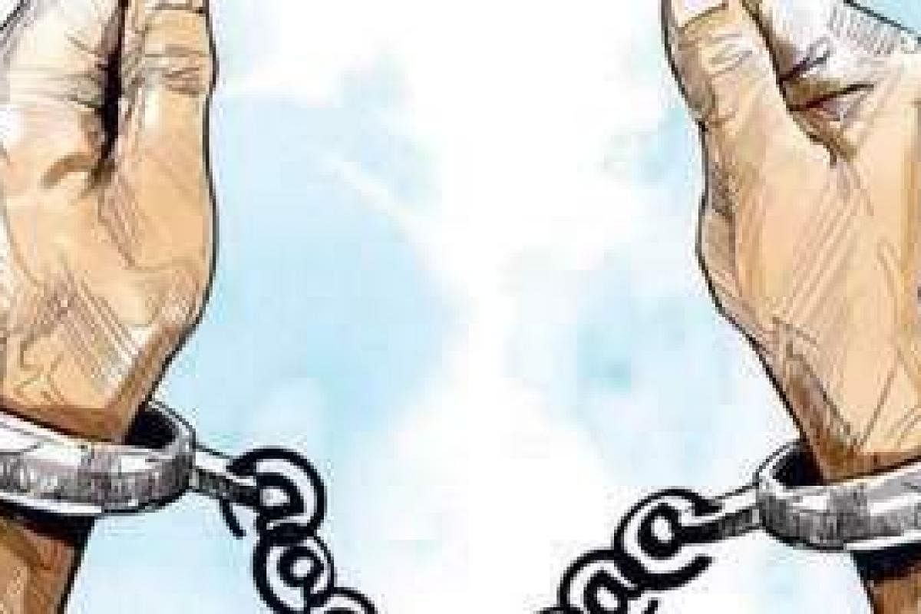
Major Crime Indicators (MCI)
An open-source dataset shared by The Toronto Police Service on their web portal.
Types of offences
Excludes incidences that have been considered unfounded.
Promotes public safety and awareness among citizens.
Notes:
MCI’s - this dataset has been chosen by us for the purpose of data analysis. It is an open source dataset readily avalaible on the web portal of the The Toronto Police Service. It gives detailed information about all types of major crimes committed across Toronto. it includes offences like Assault, Break and Enter, Auto theft, Robbery and Theft over.
This dataset doesn’t contain incidences that have been considered unfounded and when i use the term unfounded, i mean the incidences that have been reported but did not occur nor were attempted. Moreover, this initiative has been undertaken by The Toronto Police Department Service to help in promoting public safety and awareness among citizens.

Slide 6
Some of the key findings from the Major Crime Indicator (MCI)dataset are-
Notes:
now, after doing data analysis with the help of business intelligence tool tableau, we have reached to the following key findings in our dataset.

Slide 7
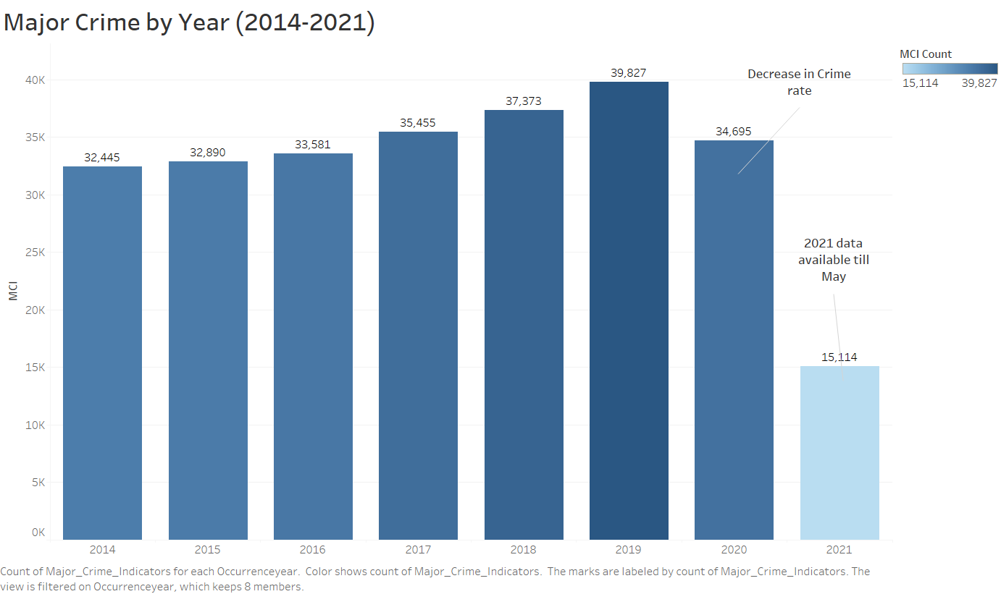
1. Major Crime rate from 2014 till 2021
Notes:
our first major key finding is- the rate of crimes occured over the years in toronto, particulary from 2014 till 2021. With the help of the vertical bar chart we can see that from 2014 till 2019
crime rate experiences an upward trend which means there has been a steady increase in the no of crime cases reported. Reaching from around 3200 cases in 2014 to 40000 by 2019.
However, from 2020 onwards the chart follows a downward trend which shows that there has been a sudden decrease in crime rate by cases falling to around 35000 in 2020.

Slide 8
Key findings-
The vertical bar chart shows an increase in crime cases reported from 2014 till 2019.
From 2020 onwards, chart shows a downward trend in crime rate.
Maximum number of cases were reported in 2019
Notes:
Hence, to summarize our findings for crime rate over the years, first-
Second - …which can be due to incoming of covid 19 pandemic .

Slide 9
2. Crimes by Offense Type
Notes:
Let's get started with an interesting bubble chart, bubble chart gives the user a clear interpretation of data, without showing any axis., We can compare and visualize the data smartly. This bubble chart is prepared by us to compare the crime by offense type, which gave us an interesting visualisation. Assault was the major offense type in and around Toronto which contributes to 53% of whole crimes. Next major offense type is break and enter with 20.37%, Auto theft with 12.39%, Robbery with 10.08% and theft over with 3.31%

Slide 10
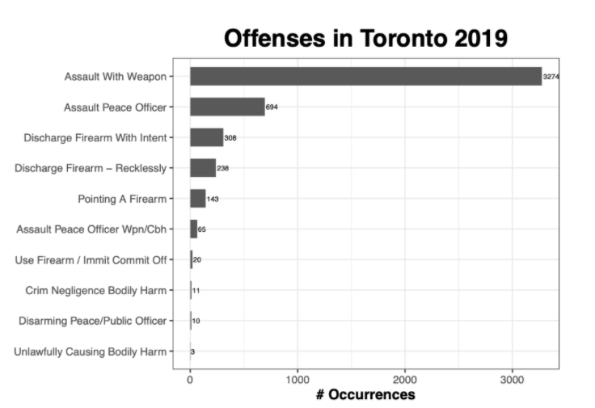
https://medium.com/analytics-vidhya/major-crime-indicators-in-toronto-2019-dbbeaeb01d12
Notes:
Assault being the major crime category, the following chart from a similar research gives us the information that under the assault offense type, assault with weapon is the sub category which contributes to the most of the assault offenses.

Slide 11
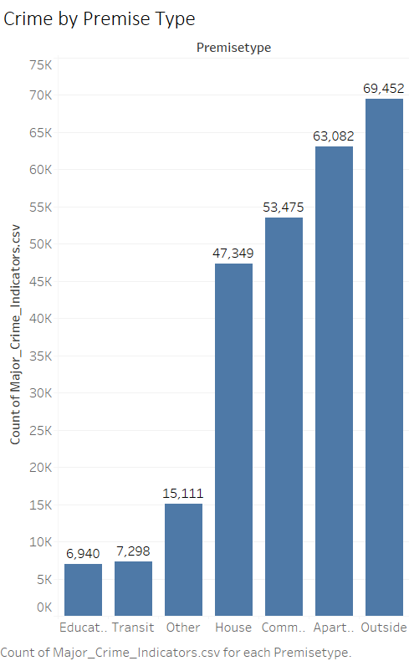
3. Crimes by Premise Type

Slide 12
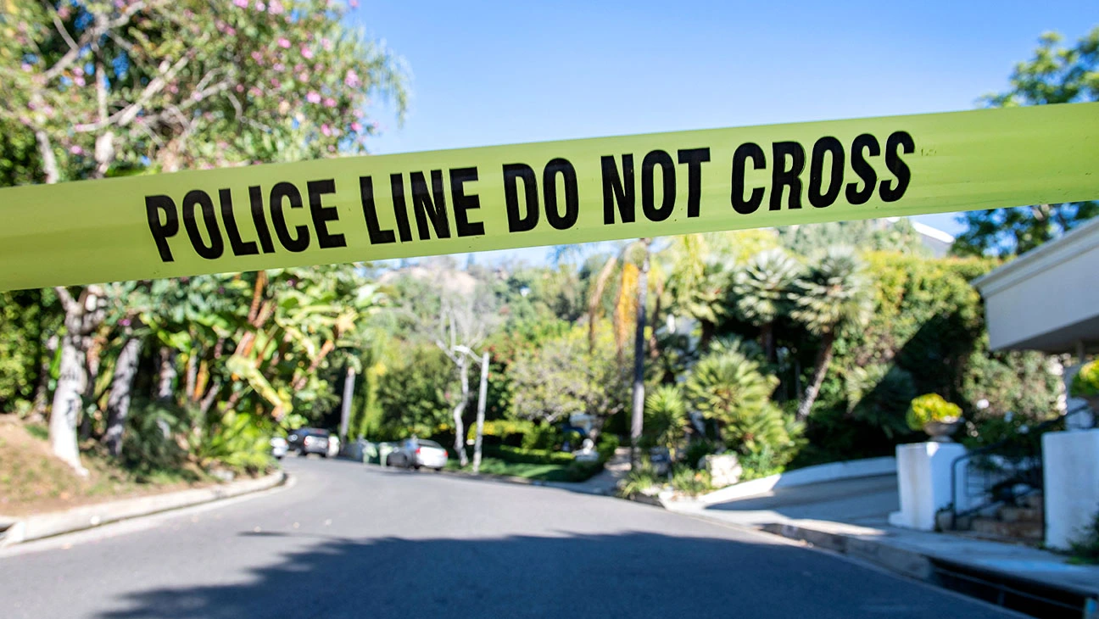
Crime by Premise Type
The bar chart shows the total number of major crime indicators versus the type of premises where they occur.
The data has been sorted in ascending order.
The maximum number of crimes occurs outside.
The least number of crimes occur on educational premises

Slide 13
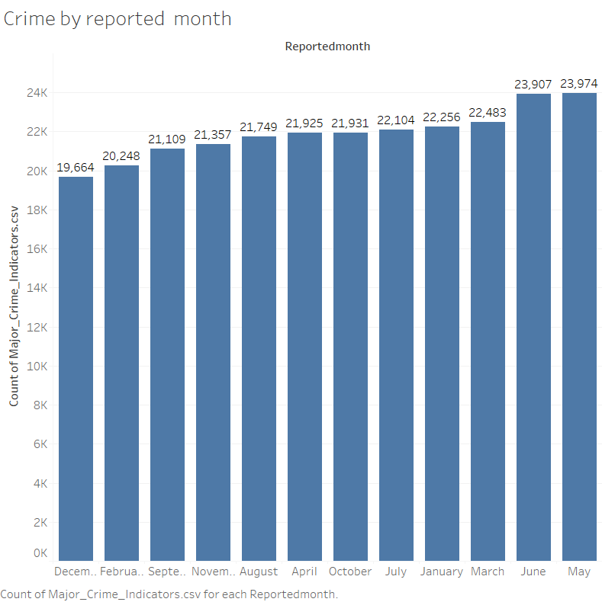
4. Crimes by Reported month

Slide 14

Crime by Reported month
The chart shows the total number of crimes that occur in different months of the year
The months have been arranged in ascending order based on the total count of major crime indicators.
The maximum number of crimes are reported in the month of May
The least number of crimes are reported in the month of December.

Slide 15
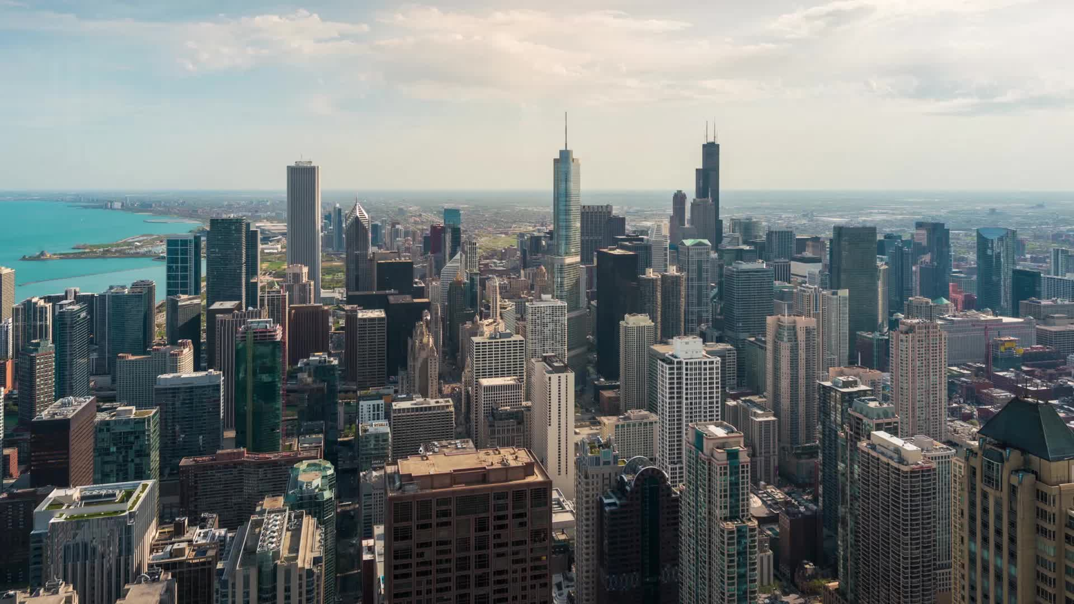
Recorded crimes have been increasing at a constant pace across Toronto from 2014.
Crimes reported have been increasing at a rate of ~2% YoY with the peak touching in 2019 and then dropping sharply in 2020.
Imposed lockdowns and other extreme measures could have contributed to the decrease in crimes reported in 2020.

Slide 16
Increase of crimes reported rose to 7.4%* in 2019 as compared to 2018
*which is 16.3% of the total crimes reported so far during the period from 2014 to 2020

Slide 17

Recommendations
Understand the reason behind the steady increase in crimes over the years
Why did the crime count reduce in 2020 – actual reduction or lack of reporting?
Conduct awareness workshops to promote reporting of crimes
Increase patrolling once lockdowns are lifted to ensure the trend doesn’t return.

